Slide 1
DAVID MWITI MUTHIRU
Phase 1 project submission
A Cross-film analysis

Slide 2
Business Problem
Microsoft sees all the big companies creating original video content and they want to get in on the fun. They have decided to create a new movie studio, but they don’t know anything about creating movies. You are charged with exploring what types of films are currently doing the best at the box office. You must then translate those findings into actionable insights that the head of Microsoft's new movie studio can use to help decide what type of films to create.

Slide 3
SOLUTION
Based on the problem above, an analysis to get to know the best genres to produce.
This will be based on 2 datasets, one from Rotten Tomatoes and another from IMDB
We’ll get to see the best movie length based on the two datasets
Lastly well get to see the best directors for the job based on the different genre ratings

Slide 4
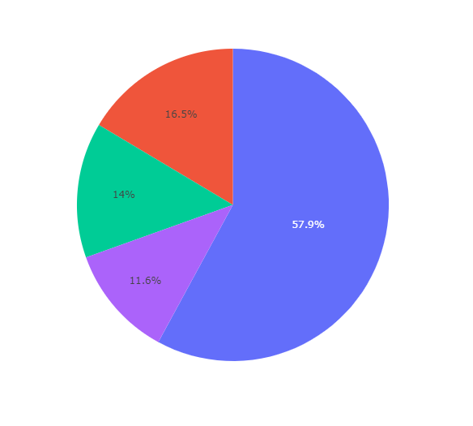
PIE CHART REPRESENTATION OF THE MOVIE RATING RATIOS
R – 57.9%
PG-13 – 16.5%
PG - 14%
NR – 11.6%
The most prevalent movie rating is the R rated movies

Slide 5
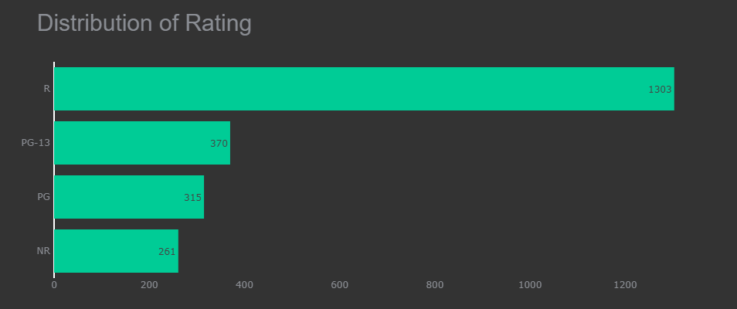
Distribution of Rating
This diagram shows the distribution by count of each Movie rating
The pyplot library was used in displaying the figure

Slide 6
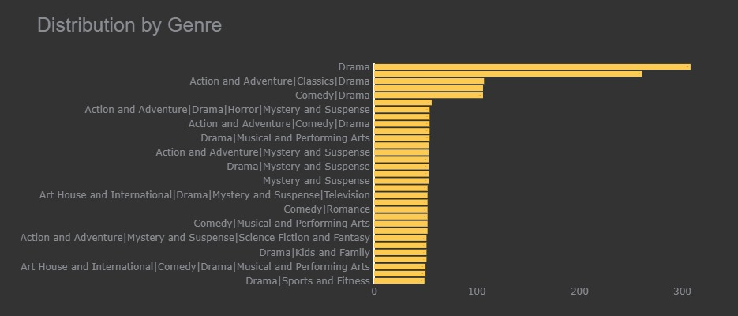
Distribution of the Different Genres
This is a display of the various Genres of movies
By the figure, the most produced genre is of Drama type, closely followed by Action and adventure which is also combined by the drama genre.
All top Genre combinations involve the Drama type

Slide 7
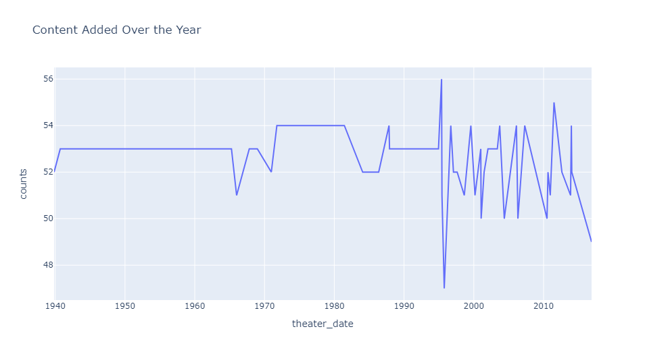
YEARS VS THE NUMBER OF MOVIES PRODUCED
This is a display of the movies produced over the years.
There seems to be no discernable tell in this figure as the count vary from year to year

Slide 8
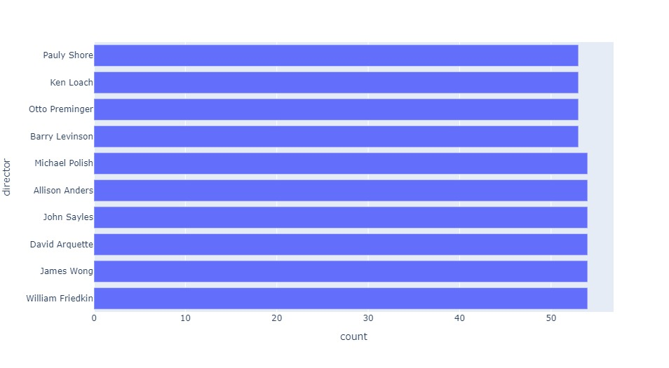
DIRECTOR RATING BASED ON THE DIFFERENT MOVIE RATINGS
Here we want to have a look at the top directors based on different Rated movie types
This Figure displays the Top 10 directors in producing an R rated movie

Slide 9
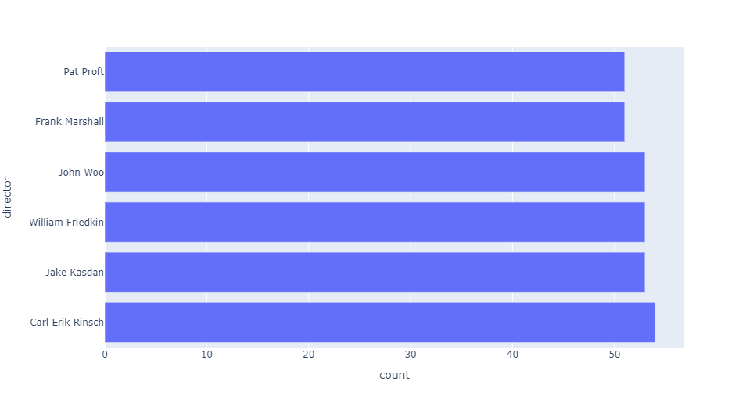
DIRECTOR RATING BASED ON THE DIFFERENT MOVIE RATINGS
This Figure displays the Top 10 directors in producing an PG_13 rated movie

Slide 10
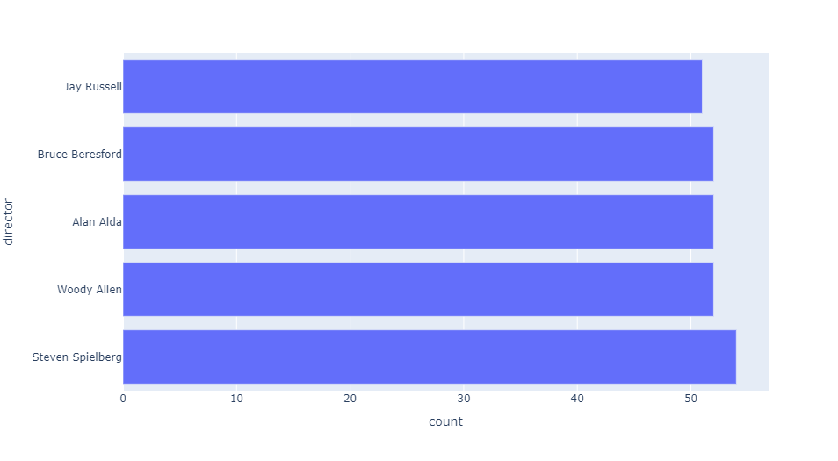
DIRECTOR RATING BASED ON THE DIFFERENT MOVIE RATINGS
This Figure displays the Top 10 directors in producing an PG rated movie

Slide 11
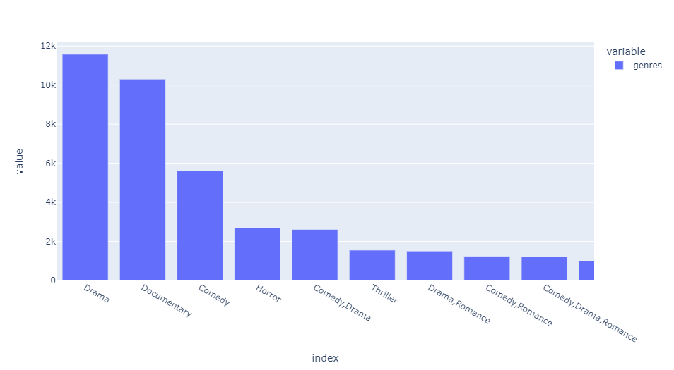
This is a breakdown of the IMDB Dataset
We can see that the top genres in the imdb dataset
Here the most voted for movies are of type Drama and Documentaries

Slide 12
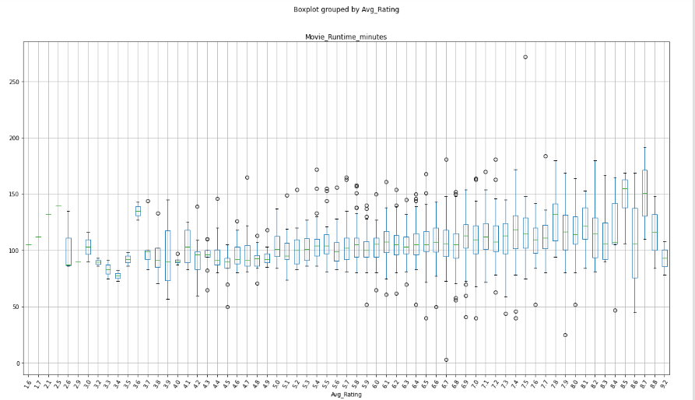
A box plot Representation of the average rating in line with the length of the movie
From the Boxplot it is evident that movies ranging from 100 – 120 minutes are mostly rated.

Slide 13
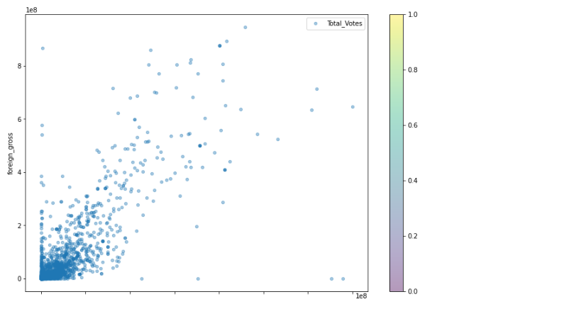
Correlation between the foreign and domestic gross
From The figure there is a moderate correlation between the foreign and domestic gross, where a rise in one leads to a rise in another.
The correlation is about 0.7

Slide 14
Recommendations and conclusion
From the above analysis, I would recommend that Microsoft eith invests in a movie of either the genre Drama or in a Documentary
At the same Time the movie length should be considered at about 100 minutes to 120 minutes as this length has a higher possibility of watchers rating the movie which helps gather more insight into it
Lastly, The best directors to consider for the movies would be
William Friedkin, James Wong, Steven Speilberg, woody Allen, carl Eric or Jack kasdan who are top rated across Genres

